Slide 1
The EDGE Information and news that gives you an edge in the real estate business
In This Week’s “The EDGE”
• Update From Our Chairman
• Houston Market Movements
• Negotiate Your Future
“The Edge” is a weekly tool for managers to use to inform their agents and stay current and up-to-date with important real estate industry issues.
Brought to you by the HAR Communications Department.

Slide 2
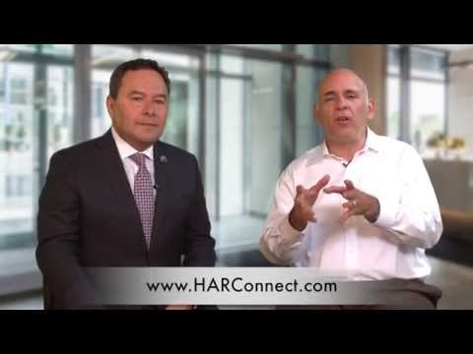
The EDGE Information and news that gives you an edge in the real estate business
Update from Our Chairman
HAR Chairman Mario Arriaga discusses two important issues for our members in the June Chairman’s Update video below. These include:
NAR’s Call for Action in support of H.R. 3700, the Housing Opportunity Through Modernization Act. This legislation provides significant benefits to taxpayers, homebuyers and the real estate market. (Click on this link to urge your U.S. Senators to bring H.R. 3700 to the Senate Floor for a vote!)
The approaching deadline (July 1) to sign up for MLS Platinum (click this link for a complete list of products and services with the MLS Platinum package).
If you have problems viewing the video, click the following link http://bit.ly/2903wcc

Slide 3
The EDGE Information and news that gives you an edge in the real estate business
Houston Market Movements
Like summer temperatures, home prices across the U.S. continue to rise in most housing categories and geographic submarkets. Meanwhile, hopeful buyers are wishing for more options to fulfill the perfect fit. As we reach deeper into summer, dips in home sales are not unexpected. Even while people search for homes in which to move or start a family, summer is also about family time in other ways. What’s happening locally? Let’s look!
In the Houston region, for the week ending June 19:
• New Listings increased 15.0% to 2,849
• Pending Sales increased 17.6% to 2,050
• Closed Sales decreased 1.0% to 1,864

Slide 4
The EDGE Information and news that gives you an edge in the real estate business
Negotiate Your Future
Certified Negotiation Expert (CNE-2)
*These courses may be taken in any order. Day One covers advanced negotiation techniques for buyer’s agents. Day Two covers working more effectively with listing agents mastering written negotiations in real estate.
Certified Negotiation Expert designation awarded at the end of Day Two (no annual or renewal fee) • 12 MCE Credit Hours • Student Manuals • Credit Towards the Master Certified Negotiation Expert (MCNE) Designation • Greater confidence in ALL your negotiations • Customizable forms to attract more Buyers and get better results • Better results for your clients and yourself!
Dates: July 11& 12 at HAR Central
July 13 & 14 at HAR Montgomery County
Time: 9 a.m. to 4 p.m.
Investment: $249
Questions? Call 713.629.1900 ext. 6

